Slide 1
Nivo-Nasdaq
“If ya ain’t first, ya last”

Slide 2
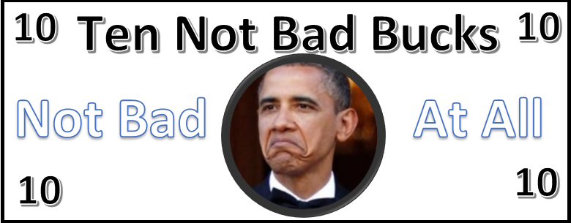
Nivo-Nasdaq
Stock | Mechir1 | Mechir2 | Shinui
Bumps on Josh Garber’s Nose (BJGN) | $0.10 | $0.12 | +9%
Curviness of Alex Garber’s Nose (CAGN) | $1.33 | $1.35 | +2%
Ephraim Rosenberg’s West Virginia Kova (EWVK) | $5.00 | $3.50 | -30%
Ethan Leifman’s HammocK (ELH) | $10.00 | $12.50 | 0%
“If ya ain’t first, ya last”

Slide 3
Nivo-nasdaq
Success of this Peulah (SKNN)
Ephraim’s West Virginia Kova (EWVK)
Machon Banot Unity (MBU)
Maddie Gelfand Tefilot Energy (MGTE)
Table Manners in Chadar Ochel (TMCO)

Slide 4
Nivo-Nasdaq
Stock | Mechir1 | Mechir2 | Shinui
Success and Kef of Nivo-Nasdaq (SKNN) | $15.00 | $21.50 | +10%
Machon Banot Unity (MBU) | $5.00 | $11.70 | +30%
Chatzi Kaddish (CHKD) | $5.00 | $5.90 | +18%
Maddie Gelfand Tefilot Energy (MGTE) | $2.00 | $1.05 | -30%
Sif Water (SIF) | $20.00 | $21.42 | +2%
“If ya ain’t first, ya last”

Slide 5
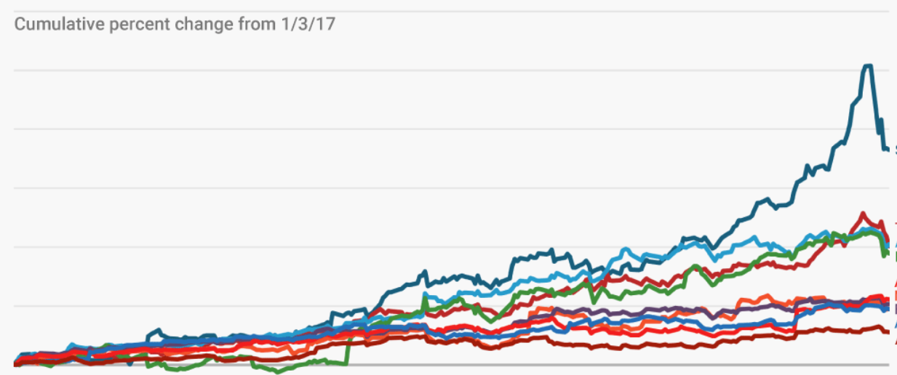
Nivo-NasdAQ
Sif Water (SFW)
Sophie Sitting anywhere (SOYA)
Marp Attendance during Limud (MADL)
Old Bay Usage (OBU)
Jake Hyman Futures (JHYF)

Slide 6
Nivo-Nasdaq
Stock | Mechir1 | Mechir2 | Shinui
Marp Attendance during Limud (MADL) | $4.00 | $5.28 | +20%
Sophie Fogel Sitting Anywhere (SOYA) | $2.00 | $2.37 | -5%
Old Bay Usage (OBU) | $15.00 | $16.00 | -20%
Shir Hamolot (SHM) | $3.50 | $3.60 | +3%
Jake Hyman Futures (JHY) | $0.80 | $0.60 | +0%
“If ya ain’t first, ya last”

Slide 7
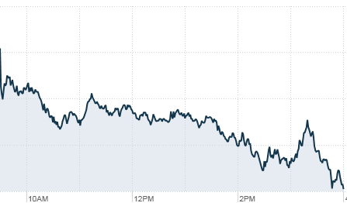
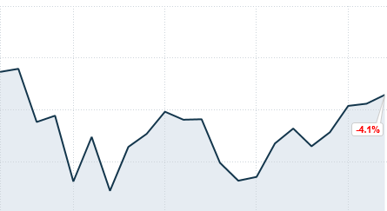
Nivo-NasdAQ
Shininess of Didi’s Head (BALD)
Sif Water Usage (Sif)

Slide 8
Nivo-Nasdaq
Stock | Mechir1 | Mechir2 | Shinui
Fruit by the Foot (FBF) | $2.50 | $2.00 | -20%
Allergen Station (ALGS) | $3.00 | $2.40 | +20%
Binyan Banim Cleanliness (BBC) | $12.00 | $9.00 | -10%
Tilt of Aryeh’s Kipah (TAK) | $1.55 | $1.50 | +15%
Shira & Misha Train Train BBYO Clothing (BBYC) | $2.00 | $2.02 | +1%
“If ya ain’t first, ya last”

Slide 9
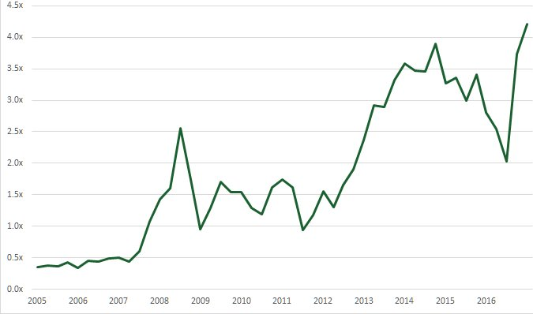
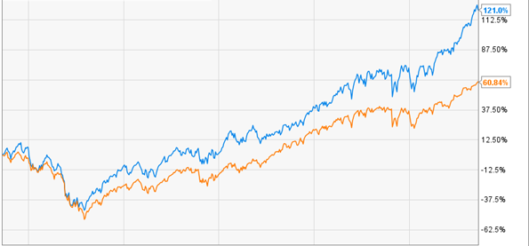
Nivo-NasdAQ
Binyan Banim Cleanliness (BBC)
Nina Katz Running (NKR)
Josh Edelglass Collered Shirts (JECR)

Slide 10
Nivo-Nasdaq
Stock | Mechir1 | Mechir2 | Shinui
Ethan Leifman’s Eyes (ELE) | $4.00 | $4.68 | +17%
Tali’s Hatred of Hammocks (THH) | $3.00 | $2.65 | +18%
Brocha Achronah (BCH) | $5.00 | $4.20 | -20%
Orli Katz Hair Curliness (OKHC) | $1.50 | $1.22 | -10%
Josh Sherman Batting Average (JSBA) | $2.00 | $2.10 | +5%
“If ya ain’t first, ya last”

Slide 11
Nivo-Nasdaq
Stock | Mechir1 | Mechir2 | Shinui
Ariel Creditor Torah Reading Consistency (ACTR) | $2.00 | $1.60 | -20%
Shininess of Didi’s Head (BALD) | $28.00 | $34.60 | +30%
Lily Segal Happiness (LSH) | $0.50 | $.65 | +30%
Aryeh telling Chanichim to wear Headcoverings (ACWH) | $5.00 | $5.50 | +0%
Palmer Soccer Roster Size (PSRS) | $9.00 | $9.00 | +0%
“If ya ain’t first, ya last”

Slide 12
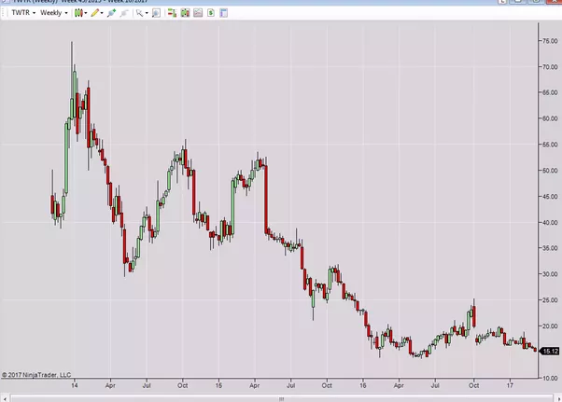
Nivo-NasdAQ
Tali’s Hatred of Hammocks (THH)

Slide 13
Nivo-Nasdaq
Stock | Mechir1 | Mechir2 | Shinui
Didi’s Inability to Sing (DIS) | $2.00 | $2.10 | +0%
Chanichim Asking when Yom Sport is (CAYS) | $5.00 | $7.80 | +30%
Potatoes in the Chadar (PIC) | $3.05 | $2.75 | +0%
Camp Feet (CFT) | $4.00 | $4.60 | +15%
Nina Katz Running (NKR) | $2.00 | $1.98 | -10%
“If ya ain’t first, ya last”

Slide 14
Nivo-Nasdaq
Stock | Mechir1 | Mechir2 | Shinui
Dav’s Yankees Hat (DYH) | $3.00 | $3.30 | +10%
Josh Edelglass Collared Shirts (JECS) | $3.00 | $4.31 | +15%
Playinwitme by Kehlani (PLAY) | $13.00 | $10.40 | -20%
Umbrellas Being Used (UBU) | $8.00 | $9.68 | +20%
Eve’s Nicknames Usage (ENU) | $5.00 | $.85 | -15%
“If ya ain’t first, ya last”

Slide 15
Nivo-Nasdaq
Stock | Mechir1 | Mechir2 | Shinui
Jake and Joey Shoyer Power Struggle (JJSP) | $2.00 | $5.20 | +30%
Marcia Glickman Director Chair (MGDC) | $2.50 | $1.50 | 0%
Little House (LH) | $5.00 | $5.75 | +15%
Niv Promposals (NPP) | $17.00 | $10.42 | -25.6%
Bunk 84 A/C Unit | $3.00 | $2.7 | -10%
“If ya ain’t first, ya last”

Slide 16
Nivo-Nasdaq
Stock | Mechir1 | Mechir2 | Shinui
Palmer Ball Brotherhood Strength (PBS) | $5.00 | $5.50 | +0%
JV Palmer Dance (JVPD) | $6.00 | $8.18 | +20.33
David Franzeen Poker Career (DFPC) | $10.00 | $8.80 | -20%
Avi Snowise Josh Azia Frienship (AJAF) | $2.00 | $2.10 | +5%
Jesse Wolfe Afro (JWA) | $1.13 | $5.59 | +30%

Slide 17
Nivo-Nasdaq
Stock | Mechir1 | Mechir2 | Shinui
Buffet Style Chadar Food (BSCF) | $3.75 | $6.00 | +50%
Ben Kane reading Naked Economics and thinking he knows everything about the stock market (BANE) | $5.00 | $8.62 | +15%
Matan's Hebrew Accent During Birkat Hamazon (MHAB) | $3.00 | $4.29 | +30%
Sandra Gerson Phone Access (SGPA) | $20.00 | $18.13 | +45%
Jared's Torso (JTO) | $0.20 | $0.16 | -25%
“If ya ain’t first, ya last”

Slide 18
Nivo-Nasdaq
Stock | Mechir1 | Mechir2 | Shinui
Knish Unibrow (KNU) | $1.00 | $.85 | -15%
Doron's Eyebrows (DFB) | $1.25 | $1.25 | +25%
Yoni Gelb Beard (YGB) | $5.00 | $5.10 | 0%
Paula Shoyer Instagram (KOSH) | $5.00 | $10.00 | 0%
Niv Banot Snack (BSK) | $12.00 | $10.40 | +4%
“If ya ain’t first, ya last”

Slide 19
Nivo-Nasdaq
Stock | Mechir1 | Mechir2 | Shinui
Camp's Beef with Rondeaus (CBR) | $15.00 | $13.82 | -7.89%
Aryeh Adjusting His Clothes (AAHC) | $3.00 | $4.69 | +25%
Girls Wearing Athletic Shorts (GWAS) | $5.00 | $5.90 | +18%
Dore Following Halacha (DFH) | $3.00 | $2.48 | -9.99%
Ben Kane Ultimate Skill (BKUS) | $10.00 | $10.60 | +6%
Ticklemonster (TMS) | $7.00 | $1.05 | -65%
Tzad Bet Agam Hatred | $5.00 | $6.00 | 0%
“If ya ain’t first, ya last”

