Slide 1
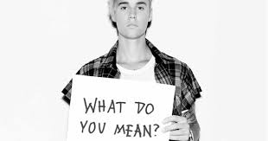
MEME?

Slide 2
How this will work:
Teams: create captions for pictures provided
Each round there will be a new category. Each team will draw a card from the bag that has a word on it that fits in the round’s category. Your meme caption must include/be based off of the word on your card.

Slide 3
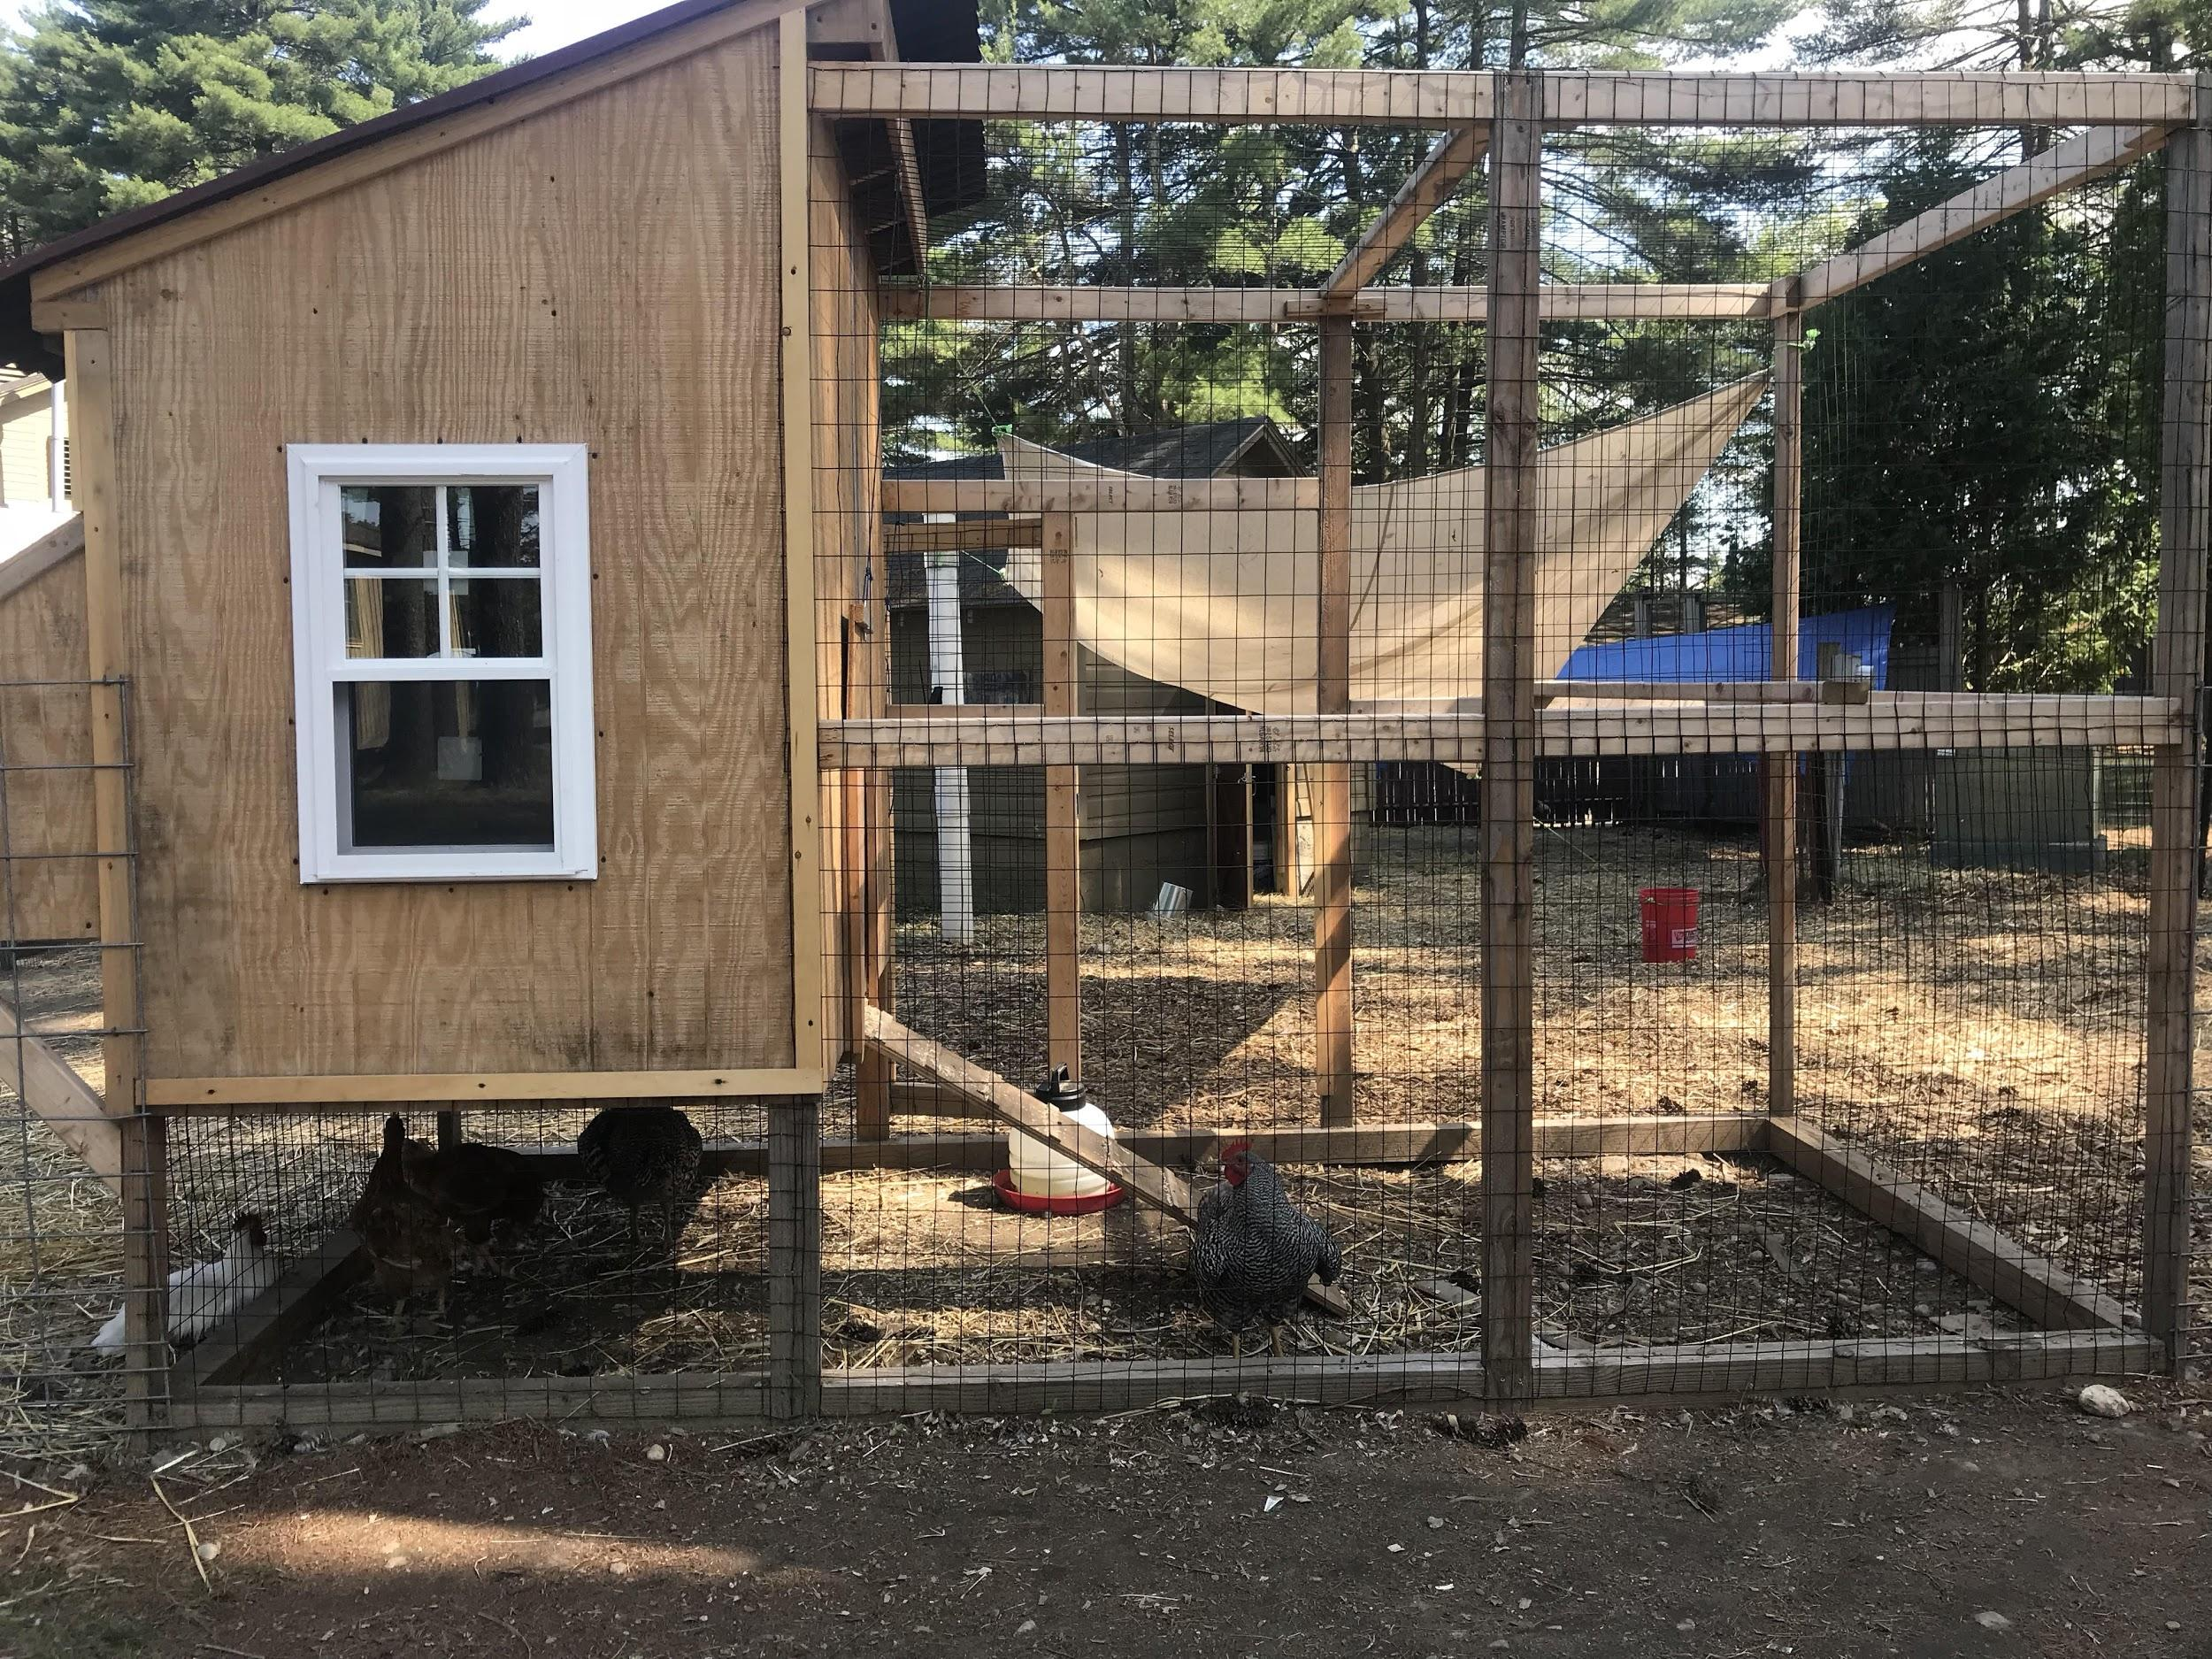
Biblical Figures

Slide 4
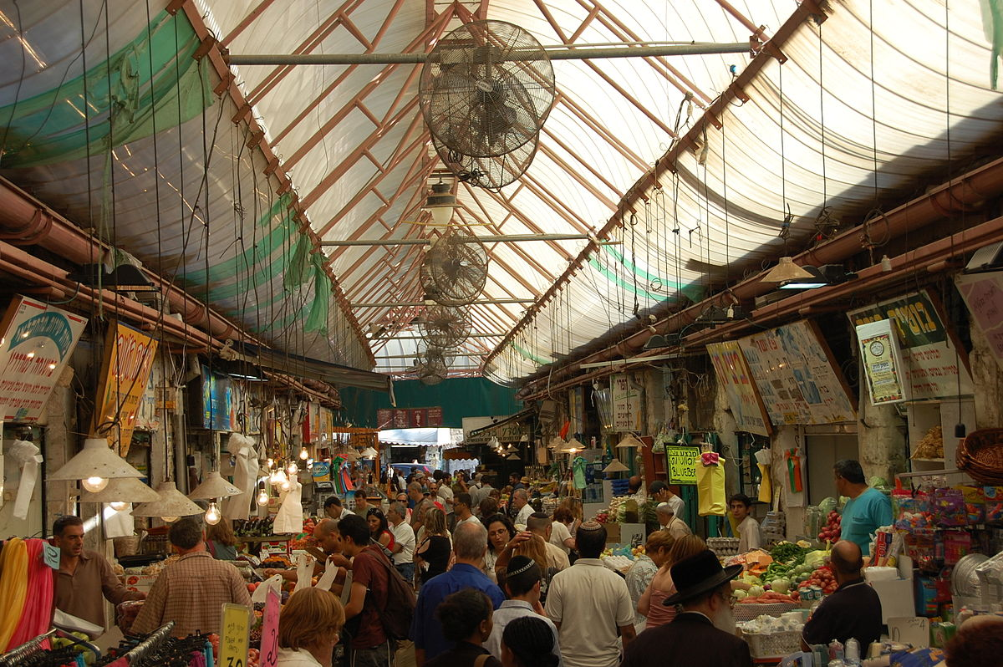
The Shuk

Slide 5
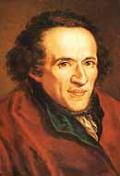
Moses Mendelssohn

Slide 6
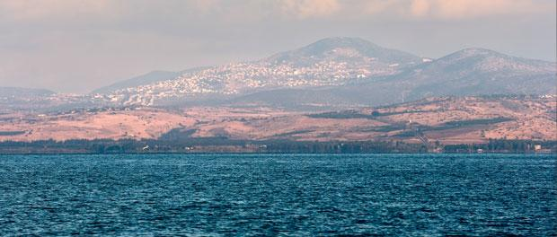
The Kinneret

Slide 7
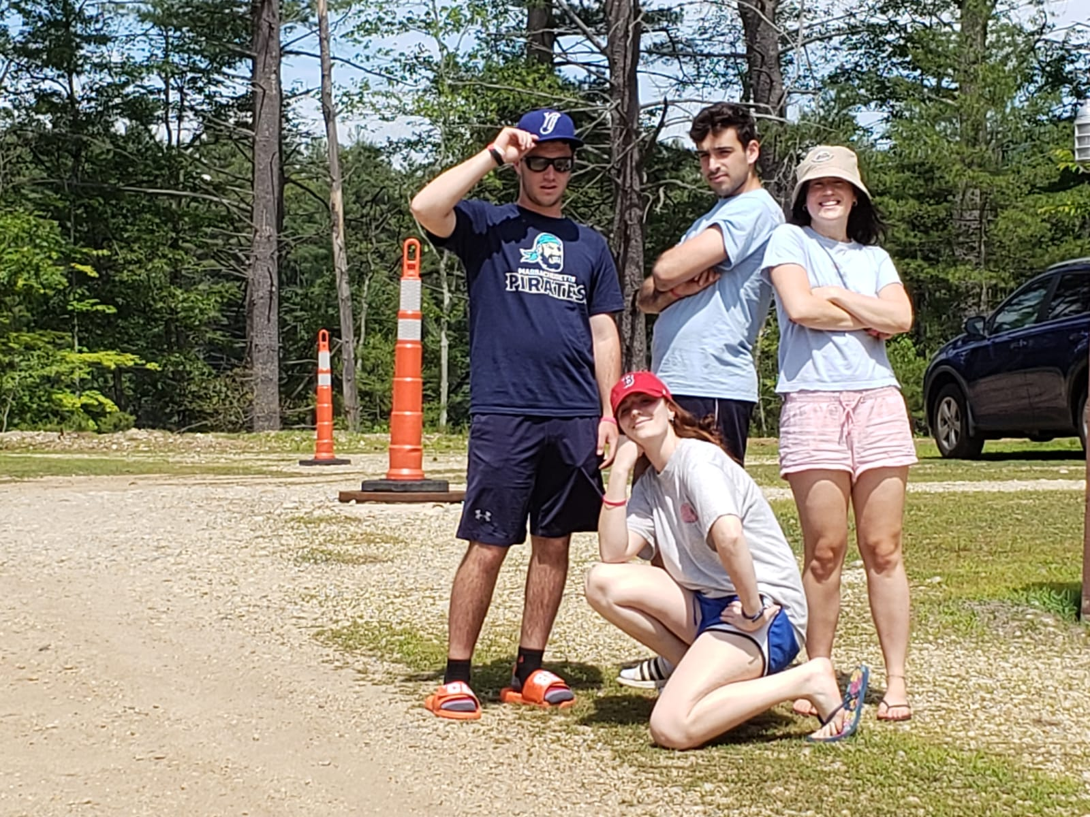
Tzevet Nivonim

Slide 8
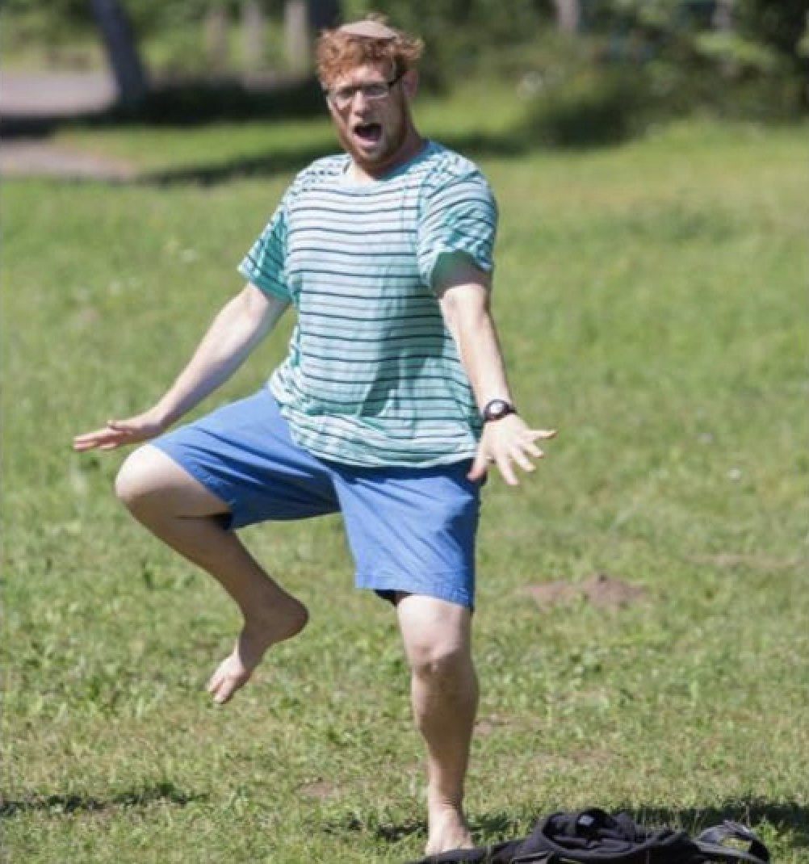
Sensei Aryeh Kalender

